Slide 1
An Introduction to Computer Vision
Department of Computer Science
Dr Hong Wei
Workshop of Computer Vision for Environment in Defra
London, 7th June 2018
Notes:
Good afternoon. It is my pleasure to give this talk. My name is Hong Wei from the Department of Computer Science, University of Reading. My research area is computer vision. I have been working in this area over 20 year. Today I’ll use 10 minutes to briefly explain to you what Computer Vision is.

Slide 2
Outline of the presentation
What is computer vision?
Computer vision, machine learning (deep learning), and artificial intelligence
Computer vision: image analysis
Computer vision: visual intelligence for pattern classification
Applications of computer vison
Notes:
First of all, I shall answer the question: what is computer vision.
Then briefly explain the relationship between computer vision, machine learning, and artificial intelligence. People may be confused time by time with these phrases.
The main work of computer vision is image analysis and pattern classification. And finally give a few examples of our previous research (applications) in remotely sensed data understanding, which may be related to today’s topic.

Slide 3
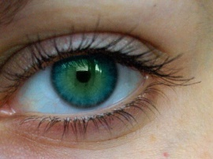
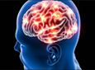
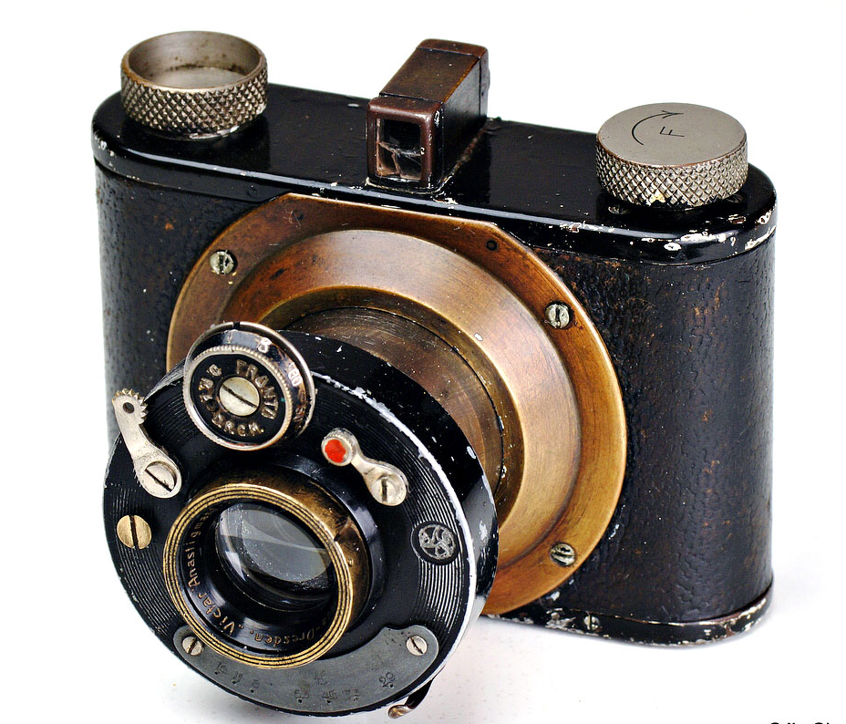
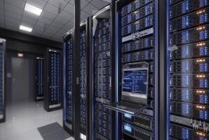
What is computer vision?
Computer vision, also named as machine vision, refers to the technology by which a computer, associated with cameras, can emulate the human vision system to see the world.
 | Perception | Cognition
Human vision | Eye | Brain
Computer vision | Camera | Computer
Notes:
In the human vision, we use our eyes to capture images in, and our brain to interpret what information contains in the images
In a computer vision system, cameras work as our eyes to capture images in to a computer, then the computer works as our brain to fulfil the task of image understanding and interpretation.

Slide 4
Computer vision, machine learning, artificial intelligence
Computer vision in the cognition end overlaps with machine learning.
Artificial intelligence is an even large domain, which covers computer vision, machine learning, and many others.
Artificial Intelligence
Machine learning
Computer Vision
Deep learning
Notes:
You may ask what the relationship is between CV, ML, and AI.
Computer vision and machine learning are two separate domains. They are overlapped when computer vision requires “cognition”.
Deep learning is a branch of machine learning. It becomes popular in recent year. It also overlaps with computer vision.
Artificial intelligence covers phycology, biology, neuroscience, social science, and many more.

Slide 5
A computer vision system
A computer vision system includes both perception (low-level vision) and cognition (high-level vision).
The core of the low-level vision is of cameras, by which images are captured into the system.
The main task of the high-level vision involves computer systems for image analysis, understanding, and interpretation in an automatic manner.
Notes:
Ok, let’s back to the computer vision system.
As we can see a computer vision system includes ….(the first point).
In the compute vision community, we refer the perception part as low-level vision, whilst the cognition part as high-level vision.
As we have mentioned, the core of ….(the second point).
(the third point ) The high-level vision concerns image analysis, understanding, and interpretation. Importantly in an automatic or semi-automatic manner.
Majority of computer vision researchers are working on high-level vision.

Slide 6
Computer vision: image analysis
The aim of image analysis is mainly for
Noise removal: pre-processing
Image enhancement for further processing
Feature extraction
Scene segmentation
Object isolation
.......
Numerous algorithms are developed for the above purposes.
Notes:
For image analysis, the main tasks are …… (the first point)
(the second point)

Slide 7
Computer vision: visual intelligence for pattern classification
Machine learning, either supervised or unsupervised, is heavily involved in automatic image understanding and interpretation.
For supervised learning, training data are usually required for training a computer to learn patterns contained in the training data.
After the training process, a model is established. A pattern classification process is performed for image interpretation.
Notes:
Visual intelligence is to build intelligence in the computer vision system for pattern classification. That is where machine learning involves.
Although we don’t exactly know how the human vision system works, we do know that learning processes are in place.
(Points 1, 2, and 3)
Again, many algorithms are used for modelling data in the training and testing processes. The state of the arts is deep learning.

Slide 8
Computer vision and deep learning
Deep learning becomes popular in the machine learning community as well as in many applications.
By using deep learning, such as Convolution Neural Network (CNN), we may omit some processes in image analysis and make image understanding purely driven by raw data.
Based on a large number of training samples, the CNN can extract meaningful features and establish the optimal model for object/pattern classification.

Slide 9
Applications of Computer vision Visual intelligence and its applications on remotely sensed data
Notes:
I’ll quickly go through a few examples from our previous work concerning computer vision for remotely sensed data understanding.

Slide 10
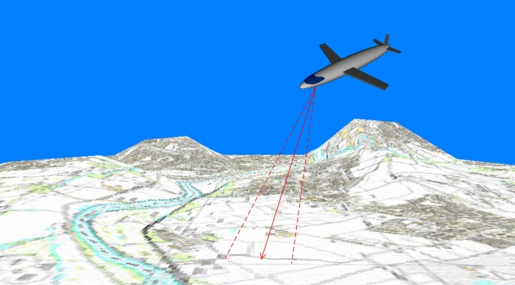
Airborne Lidar and its applications (1)
DTM generation from Lidar DSM
Land-cover classification by various algorithms
Notes:
Airborne Lidar provides us surface height information. We call its DSM (digital surface model). We developed algorithms to extract DTM (digital terrain model).
Associated with RGB and near infrared images, we developed algorithms for land-cover classification.

Slide 11
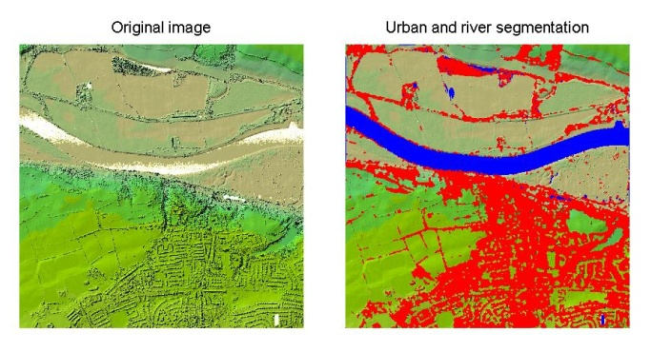
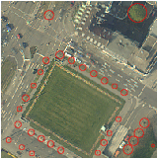
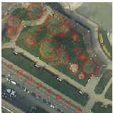
Airborne Lidar and its applications (2)
Separation of residential areas, river and green land
Unsupervised segmentation using Gabor features to identify residential areas
Tree detection
D-S evidence theory was applied to Lidar FE, LE and co-registered RGB/NIFR images to detect trees in urban areas.
Notes:
For example, (points 1&2)

Slide 12
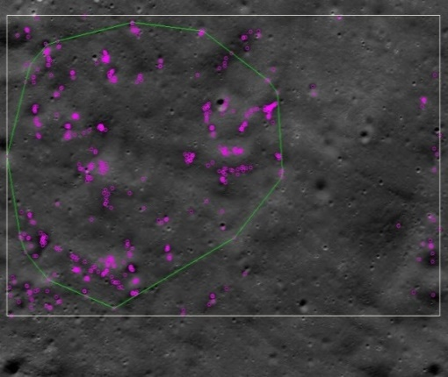
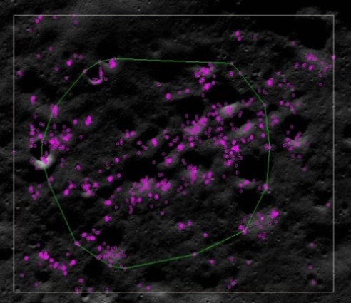
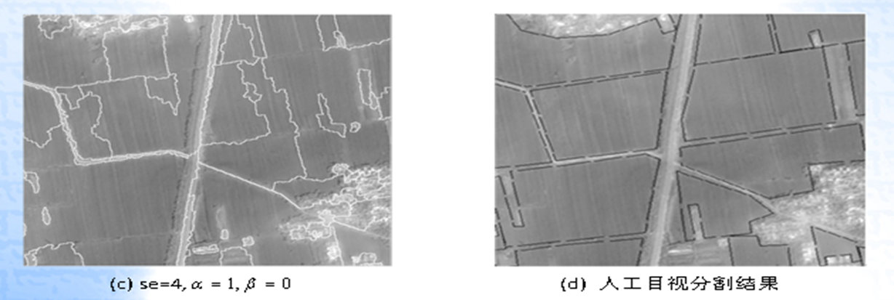
Visual intelligence for remotely sensed data
3D reconstruction from accurate image pixel registration
A 4-step ASIFT based local registration method for satellite imagery (Chang’E-2)
Monitoring crop growth
Segmentation of Gaofen-1 satellite images to identify crop areas for precision yield prediction (precision agriculture)
Notes:
We also worked on satellite images for some applications.
(point 1)
(point 2)

Slide 13
Thank you Questions?

